Slide 1




Machine Learning in Python with scikit-learn
Dr. Randy Olson
rso@randalolson.com
@randal_olson
randalolson.com

Slide 2
Who am I?
AI researcher & data scientist
B.S. in CS, Uni. Central Florida (2010)
Ph.D. in CS / EEBB, Michigan State Uni. (2015)
Lead Data Scientist, Life Epigenetics (biotech startup)
Data tinkerer
Data blog: randalolson.com/blog/
Community leader: reddit.com/r/DataIsBeautiful

Slide 3
What you will learn about
What kind of problems you apply machine learning to
Python scientific computing ecosystem
How the data should be shaped for sklearn
The sklearn interface
How to build and use sklearn ML models
Both for supervised and unsupervised ML
Cross-validation and model overfitting/underfitting
Hyperparameter optimization and grid search
Feature preprocessing in sklearn
Putting it all together with sklearn Pipelines
Teaser: Automated machine learning

Slide 4
What you won’t learn about
Advanced math/theory behind ML models
ML models outside of sklearn
XGBoost
Deep learning / Artificial neural networks
…
Advanced hyperparameter optimization
Out-of-core learning
…

Slide 5
Links
Tutorial material on GitHub:
https://github.com/rhiever/webstep-sklearn-quickstart-2019
Contact Info:
Dr. Randy Olson
rso@randalolson.com
http://www.randalolson.com
@randal_olson

Slide 6
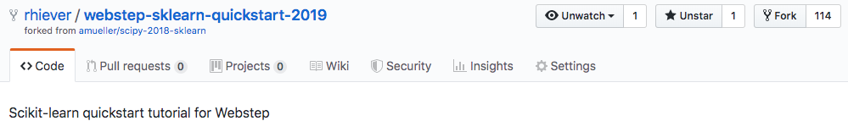
Tutorial Setup I
a) Fork the Repository (if you haven’t done so already):
b) Sync an older fork:
$ git remote add upstream https://github.com/rhiever/webstep-sklearn-quickstart-2019.git
$ git fetch upstream
$ git checkout master merge upstream/master

Slide 7
Tutorial Setup II
jupyter notebook check_env.ipynb
python fetch_data.py
~456 MB!!!

Slide 8
Tutorial Setup III
Sticky notes
Pair programming!

Slide 9
Our Agenda
Day 1 Session: Saturday, 09.00 – 16.00
Day 2 Session: Saturday, 09.00 – 15.00

Slide 10
Day 1 Session
09.00 – 16.00
01 Introduction to machine learning with sample applications
02 Scientific Computing Tools for Python: NumPy, SciPy, and matplotlib
03 Data formats, preparation, and representation
04 Supervised learning: Training and test data
05 Supervised learning: Estimators for classification
06 Supervised learning: Estimators for regression analysis
07 Unsupervised learning: Unsupervised Transformers
08 Unsupervised learning: Clustering
09 The scikit-learn estimator interface
10 Preparing a real-world dataset (titanic)
11 Working with text data via the bag-of-words model
12 Application: SMS spam classification

Slide 11
Day 2 Session
09.00 – 15.00
13 Cross-Validation
14 Model complexity and grid search for adjusting hyperparameters
15 Scikit-learn Pipelines
16 Supervised learning: Performance metrics for classification
17 Supervised learning: Linear Models
18 Supervised learning: Decision trees and random forests, ensemble methods
19 Supervised learning: feature selection
20 Unsupervised learning: Hierarchical and density-based clustering algorithms
21 Unsupervised learning: Non-linear dimensionality reduction
22 Unsupervised learning: Anomaly detection
23 Automated machine learning

Slide 12
Day 1 Session
09.00 – 16.00
01 Introduction to machine learning with sample applications
02 Scientific Computing Tools for Python: NumPy, SciPy, and matplotlib
03 Data formats, preparation, and representation
04 Supervised learning: Training and test data
05 Supervised learning: Estimators for classification
06 Supervised learning: Estimators for regression analysis
07 Unsupervised learning: Unsupervised Transformers
08 Unsupervised learning: Clustering
09 The scikit-learn estimator interface
10 Preparing a real-world dataset (titanic)
11 Working with text data via the bag-of-words model
12 Application: SMS spam classification

Slide 13
What is Machine Learning?
Inputs (observations)
“Traditional” programming
Programmer
Program
Computer
Outputs
Machine Learning is the field of study that gives computers the ability to learn without being explicitly programmed.
-- Arthur Samuel (1959)
Inputs (observations)
Machine Learning
Computer
Program
Outputs

Slide 14

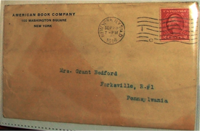

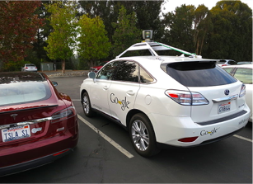
Examples of Machine Learning
https://flic.kr/p/5BLW6G [CC BY 2.0]
http://commons.wikimedia.org/wiki/File:American_book_company_1916._letter_envelope-2.JPG#filelinks [public domain]
http://commons.wikimedia.org/wiki/File:Netflix_logo.svg [public domain]
And many, many more …
By Steve Jurvetson [CC BY 2.0]

Slide 15
Generalization is key!

Slide 16
3 Types of Learning
Supervised
Unsupervised
Reinforcement
Learning from labeled data
e.g., spam classification
Discover structure in unlabeled data
e.g., document clustering
Learning by “doing” with rewards for actions
e.g., Google AlphaGo

Slide 17
Supervised Learning
Supervised
Classification
Regression
y=12.5
?
?
x=0.8

Slide 18
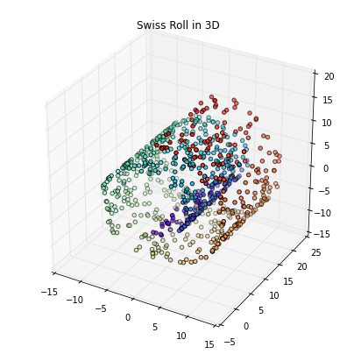
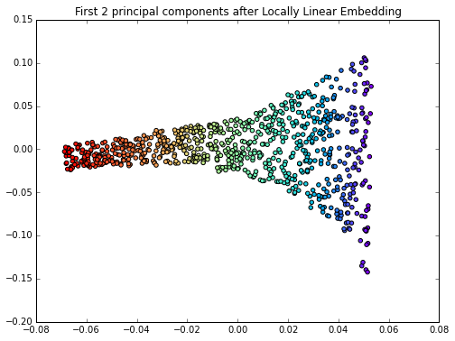
Unsupervised Learning
Unsupervised
Clustering
Compression

Slide 19
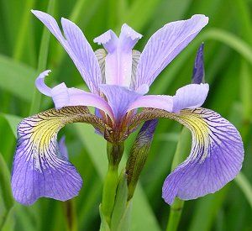
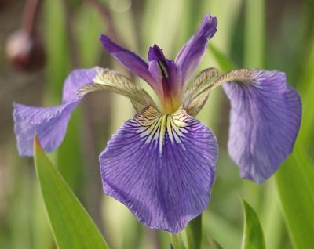
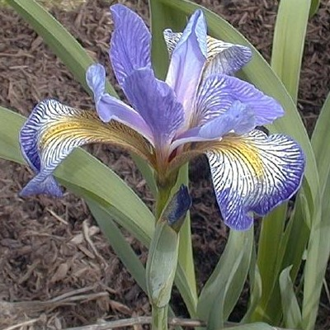
Flower Classification
Iris-Setosa
Iris-Versicolor
Iris-Setosa

Slide 20
Data Representation

Slide 21
Day 1 Session
09.00 – 16.00
01 Introduction to machine learning with sample applications
02 Scientific Computing Tools for Python: NumPy, SciPy, and matplotlib
03 Data formats, preparation, and representation
04 Supervised learning: Training and test data
05 Supervised learning: Estimators for classification
06 Supervised learning: Estimators for regression analysis
07 Unsupervised learning: Unsupervised Transformers
08 Unsupervised learning: Clustering
09 The scikit-learn estimator interface
10 Preparing a real-world dataset (titanic)
11 Working with text data via the bag-of-words model
12 Application: SMS spam classification

Slide 22
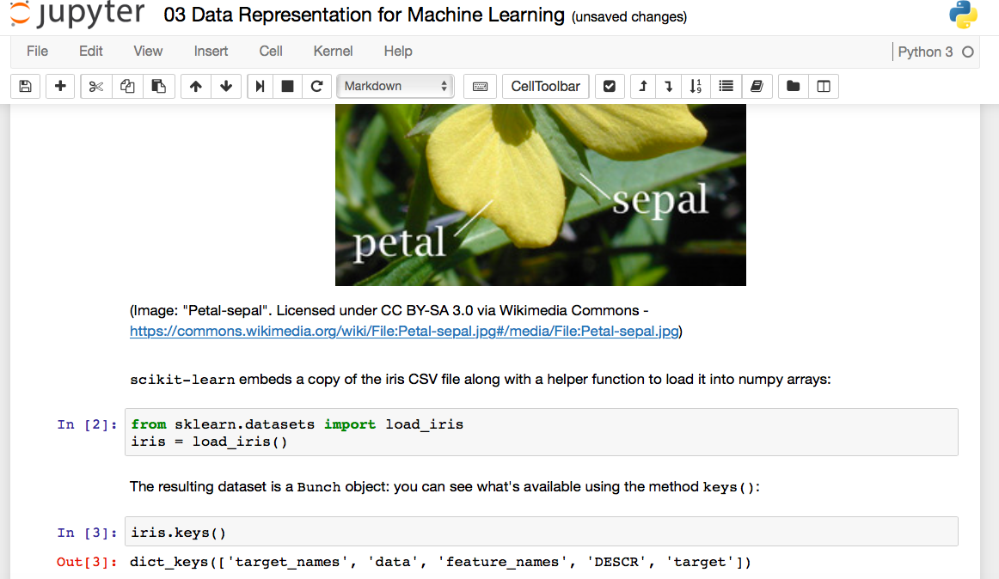
Jupyter Notebooks

Slide 23
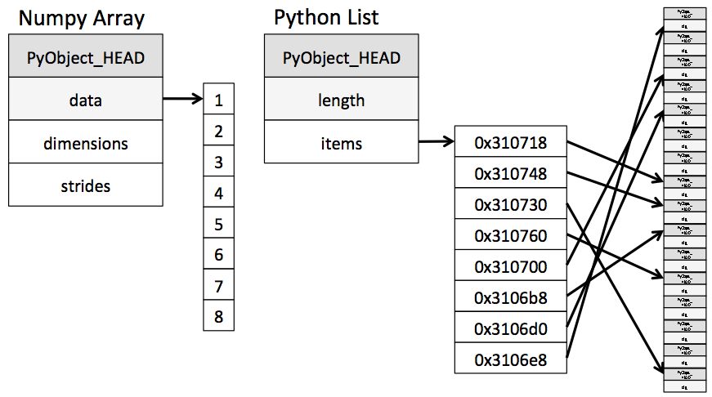
NumPy Arrays
build around a C array with pointers to a contiguous data buffer of values
Linear algebra functions
Fancy indexing
…
>>> import numpy
>>> ary = numpy.array([7, 8, 9, 10, 11])
>>> ary[[2, 4]]
array([ 9, 11])
>>> lst = list([7, 8, 9, 10, 11])
>>> lst[2, 4]]
>>> lst[[2, 4]]
Traceback (most recent call last):
File "<stdin>", line 1, in <module>
TypeError: list indices must be
integers or slices, not list
Image source: “Why Python is Slow: Looking Under the Hood” by Jake VanderPlas
http://jakevdp.github.io/blog/2014/05/09/why-python-is-slow/

Slide 24
SciPy Sparse Matrices
List of Lists (LIL) example
>>> from scipy import sparse
>>> mtx = sparse.lil_matrix([[0, 1, 2, 0],
... [3, 0, 1, 0],
... [1, 0, 0, 1]])
>>> print(mtx)
(0, 1) 1
(0, 2) 2
(1, 0) 3
(1, 2) 1
(2, 0) 1
(2, 3) 1
>>> print(mtx.toarray())
[[0 1 2 0]
[3 0 1 0]
[1 0 0 1]]

Slide 25
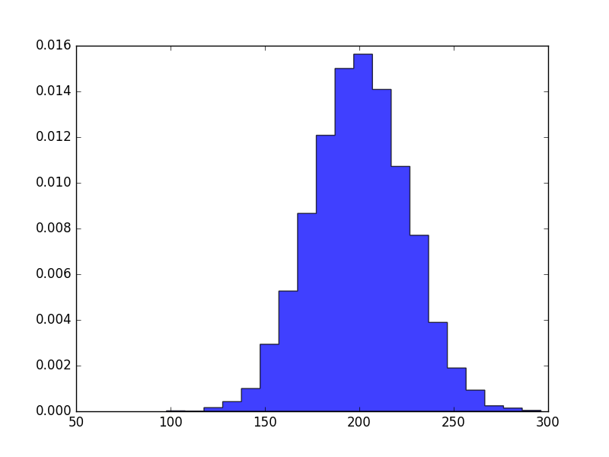
matplotlib
>>> import matplotlib.pyplot as plt
>>> import numpy as np
>>>
>>> mu, sigma = 200, 25
>>> x = mu + sigma*np.random.randn(10000)
>>> plt.hist(x, 20, normed=1,
... histtype='stepfilled',
... facecolor='b',
... alpha=0.75)
>>> plt.show()

Slide 26
Day 1 Session
09.00 – 16.00
01 Introduction to machine learning with sample applications
02 Scientific Computing Tools for Python: NumPy, SciPy, and matplotlib
03 Data formats, preparation, and representation
04 Supervised learning: Training and test data
05 Supervised learning: Estimators for classification
06 Supervised learning: Estimators for regression analysis
07 Unsupervised learning: Unsupervised Transformers
08 Unsupervised learning: Clustering
09 The scikit-learn estimator interface
10 Preparing a real-world dataset (titanic)
11 Working with text data via the bag-of-words model
12 Application: SMS spam classification

Slide 27
Iris
Iris-Setosa
Iris-Versicolor
Iris-Setosa

Slide 28
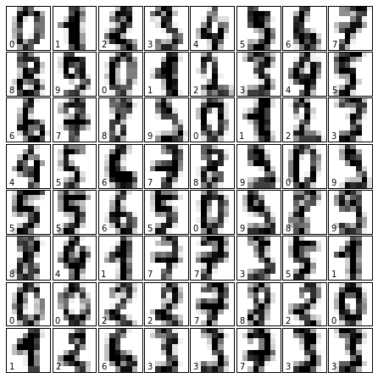
Digits

Slide 29
Generating Synthetic Data
from sklearn.datasets import make_…

Slide 30
Day 1 Session
09.00 – 16.00
01 Introduction to machine learning with sample applications
02 Scientific Computing Tools for Python: NumPy, SciPy, and matplotlib
03 Data formats, preparation, and representation
04 Supervised learning: Training and test data
05 Supervised learning: Estimators for classification
06 Supervised learning: Estimators for regression analysis
07 Unsupervised learning: Unsupervised Transformers
08 Unsupervised learning: Clustering
09 The scikit-learn estimator interface
10 Preparing a real-world dataset (titanic)
11 Working with text data via the bag-of-words model
12 Application: SMS spam classification

Slide 31
Training & Test Data
All Data
Training Data
Test Data
Typically:
75% : 25%
2/3 : 1/3

Slide 32
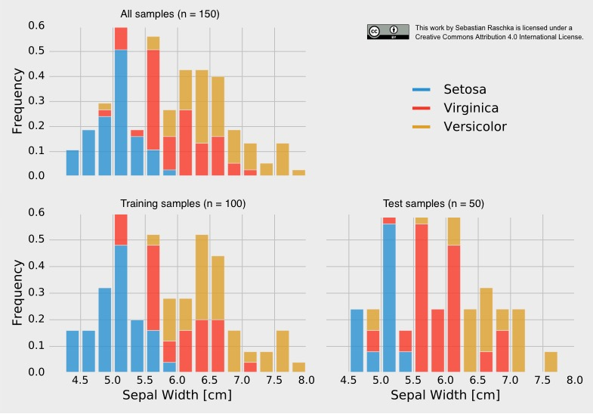
Stratification
Non-stratified split:
training set → 38 x Setosa, 28 x Versicolor, 34 x Virginica
test set → 12 x Setosa, 22 x Versicolor, 16 x Virginica

Slide 33
Day 1 Session
09.00 – 16.00
01 Introduction to machine learning with sample applications
02 Scientific Computing Tools for Python: NumPy, SciPy, and matplotlib
03 Data formats, preparation, and representation
04 Supervised learning: Training and test data
05 Supervised learning: Estimators for classification
06 Supervised learning: Estimators for regression analysis
07 Unsupervised learning: Unsupervised Transformers
08 Unsupervised learning: Clustering
09 The scikit-learn estimator interface
10 Preparing a real-world dataset (titanic)
11 Working with text data via the bag-of-words model
12 Application: SMS spam classification

Slide 34
Supervised Workflow
TRAINING
GENERALIZATION
Fit model on all data after evaluation

Slide 35
Supervised Workflow
estimator.fit(X_train, y_train)
TRAINING
estimator.predict(X_test)
GENERALIZATION
estimator.score(X_test, y_test)

Slide 36
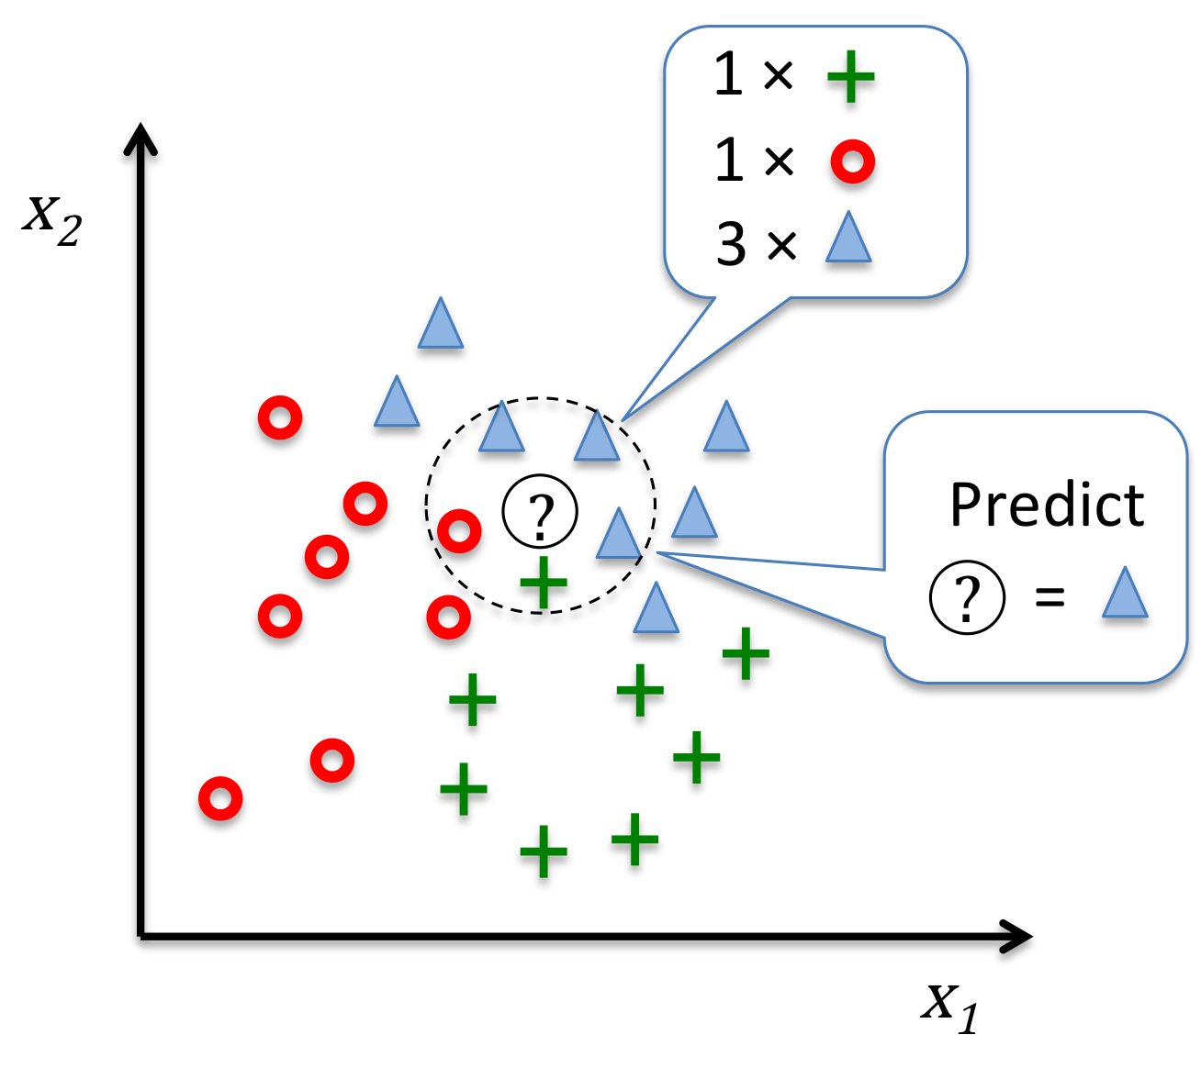
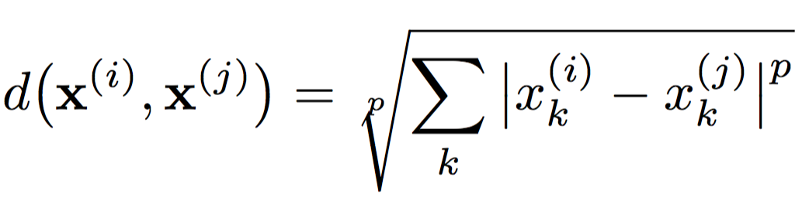
K-Nearest Neighbors
k=5
Image source: https://github.com/rasbt/python-machine-learning-book/blob/master/code/ch03/images/03_20.png

Slide 37
Day 1 Session
09.00 – 16.00
01 Introduction to machine learning with sample applications
02 Scientific Computing Tools for Python: NumPy, SciPy, and matplotlib
03 Data formats, preparation, and representation
04 Supervised learning: Training and test data
05 Supervised learning: Estimators for classification
06 Supervised learning: Estimators for regression analysis
07 Unsupervised learning: Unsupervised Transformers
08 Unsupervised learning: Clustering
09 The scikit-learn estimator interface
10 Preparing a real-world dataset (titanic)
11 Working with text data via the bag-of-words model
12 Application: SMS spam classification

Slide 38
Linear Regression
y =coef_[0]*X[0] + intercept_
y (target variable)
X[0] (feature variable)

Slide 39
Day 1 Session
09.00 – 16.00
01 Introduction to machine learning with sample applications
02 Scientific Computing Tools for Python: NumPy, SciPy, and matplotlib
03 Data formats, preparation, and representation
04 Supervised learning: Training and test data
05 Supervised learning: Estimators for classification
06 Supervised learning: Estimators for regression analysis
07 Unsupervised learning: Unsupervised Transformers
08 Unsupervised learning: Clustering
09 The scikit-learn estimator interface
10 Preparing a real-world dataset (titanic)
11 Working with text data via the bag-of-words model
12 Application: SMS spam classification

Slide 40
Unsupervised Transformers
transformer.fit(X_train)
X_train_transf = transformer.transform(X_train)
X_test_transf = transformer.transform(X_test)

Slide 41
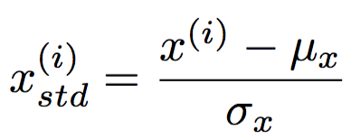
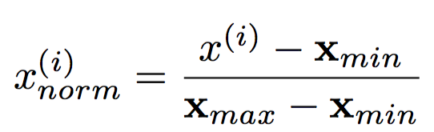
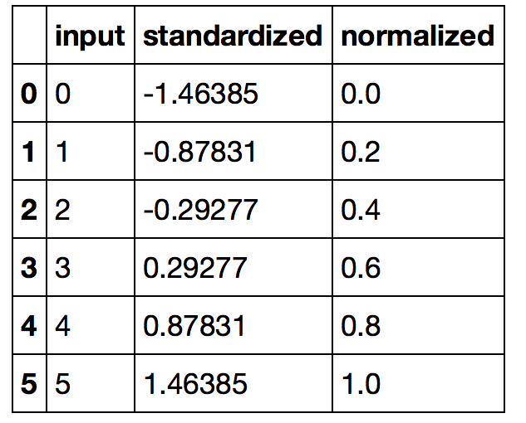
Feature Scaling
standardization
min-max scaling

Slide 42
Principal Component Analysis
PC1
PC2
x₂
x₁

Slide 43
PCA for Dimensionality Reduction

Slide 44
Day 1 Session
09.00 – 16.00
01 Introduction to machine learning with sample applications
02 Scientific Computing Tools for Python: NumPy, SciPy, and matplotlib
03 Data formats, preparation, and representation
04 Supervised learning: Training and test data
05 Supervised learning: Estimators for classification
06 Supervised learning: Estimators for regression analysis
07 Unsupervised learning: Unsupervised Transformers
08 Unsupervised learning: Clustering
09 The scikit-learn estimator interface
10 Preparing a real-world dataset (titanic)
11 Working with text data via the bag-of-words model
12 Application: SMS spam classification

Slide 45
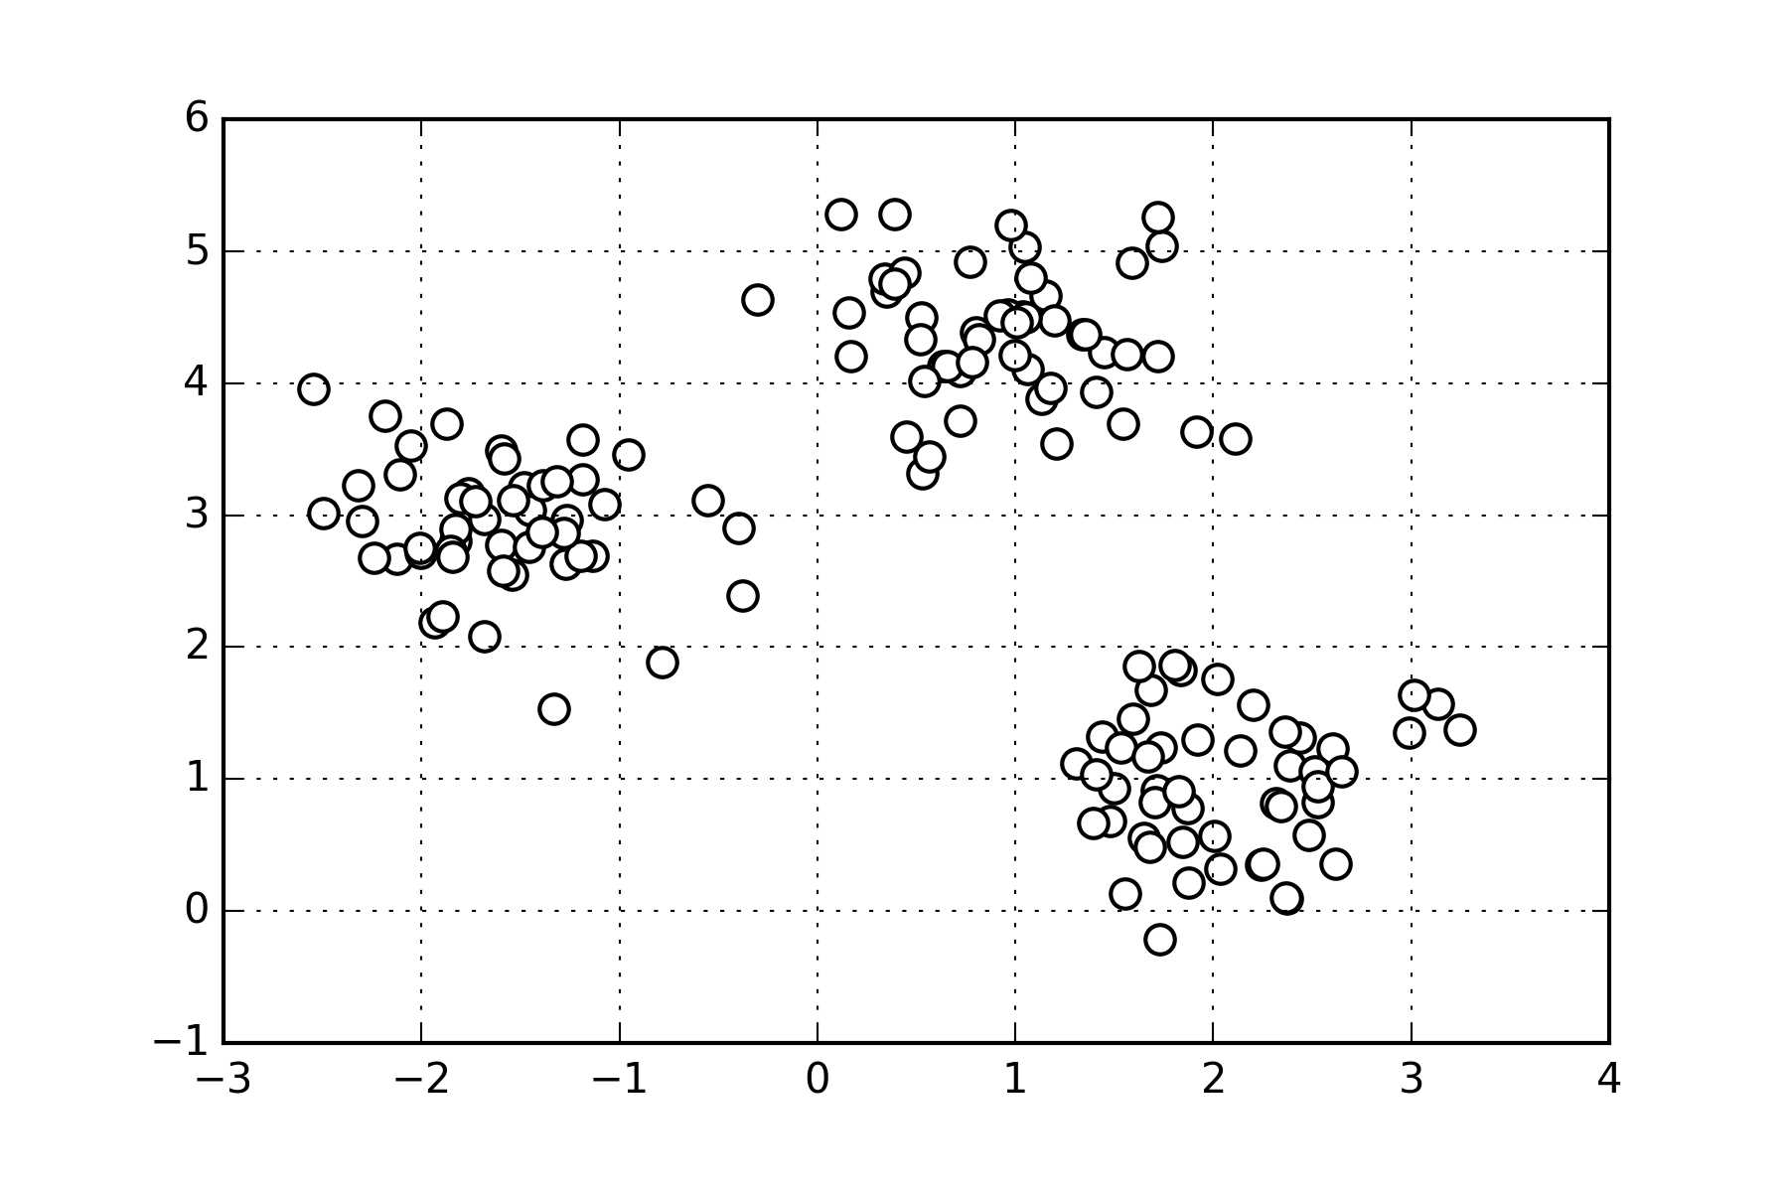
K-means Clustering

Slide 46
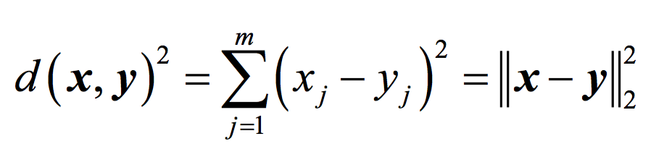
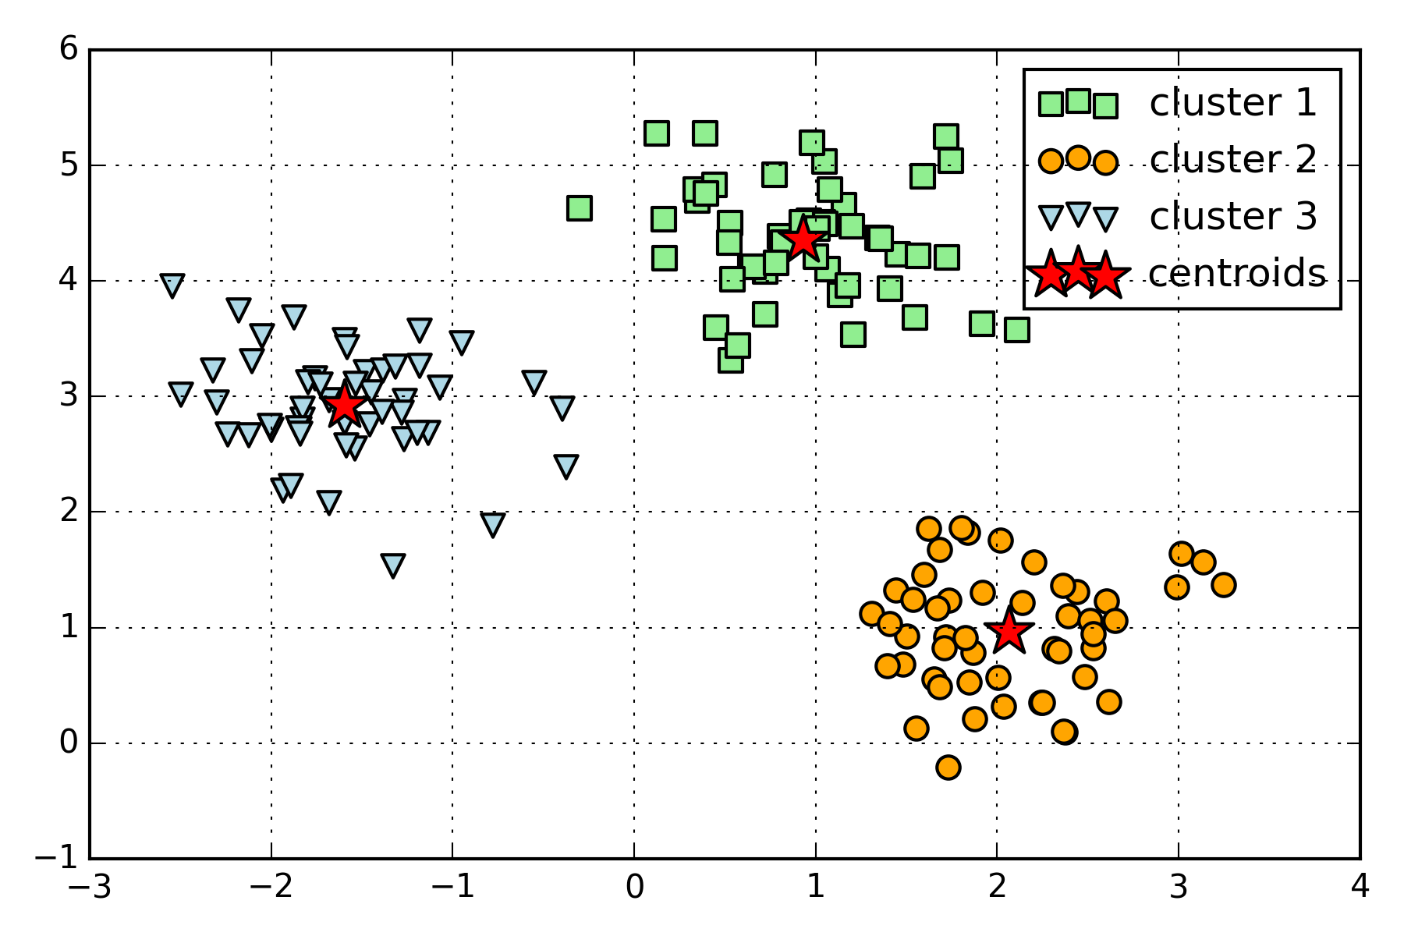
K-means Clustering

Slide 47
Day 1 Session
09.00 – 16.00
01 Introduction to machine learning with sample applications
02 Scientific Computing Tools for Python: NumPy, SciPy, and matplotlib
03 Data formats, preparation, and representation
04 Supervised learning: Training and test data
05 Supervised learning: Estimators for classification
06 Supervised learning: Estimators for regression analysis
07 Unsupervised learning: Unsupervised Transformers
08 Unsupervised learning: Clustering
09 The scikit-learn estimator interface
10 Preparing a real-world dataset (titanic)
11 Working with text data via the bag-of-words model
12 Application: SMS spam classification

Slide 48
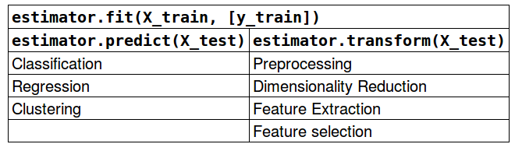
Scikit-learn API

Slide 49
Day 1 Session
09.00 – 16.00
01 Introduction to machine learning with sample applications
02 Scientific Computing Tools for Python: NumPy, SciPy, and matplotlib
03 Data formats, preparation, and representation
04 Supervised learning: Training and test data
05 Supervised learning: Estimators for classification
06 Supervised learning: Estimators for regression analysis
07 Unsupervised learning: Unsupervised Transformers
08 Unsupervised learning: Clustering
09 The scikit-learn estimator interface
10 Preparing a real-world dataset (titanic)
11 Working with text data via the bag-of-words model
12 Application: SMS spam classification

Slide 50
Continuous & Categorical Features
Continuous
Categorical
e.g., sepal width in cm
[3.4, 4.7 …]
Nominal
Ordinal
e.g., colors
[red, green, blue, …]
e.g., ratings
[satisfied, neutral, unsatisfied]

Slide 51
Case Study - Titanic Survival

Slide 52
Day 1 Session
09.00 – 16.00
01 Introduction to machine learning with sample applications
02 Scientific Computing Tools for Python: NumPy, SciPy, and matplotlib
03 Data formats, preparation, and representation
04 Supervised learning: Training and test data
05 Supervised learning: Estimators for classification
06 Supervised learning: Estimators for regression analysis
07 Unsupervised learning: Unsupervised Transformers
08 Unsupervised learning: Clustering
09 The scikit-learn estimator interface
10 Preparing a real-world dataset (titanic)
11 Working with text data via the bag-of-words model
12 Application: SMS spam classification

Slide 53
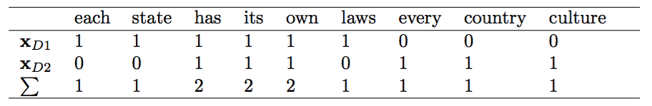
Bag of Words
• D1: ”Each state has its own laws.” • D2: ”Every country has its own culture.”
V ={each:1, state:1, has:2, its:2, own:2,
laws: 1, every: 1, country: 1, culture: 1}

Slide 54
Day 1 Session
09.00 – 16.00
01 Introduction to machine learning with sample applications
02 Scientific Computing Tools for Python: NumPy, SciPy, and matplotlib
03 Data formats, preparation, and representation
04 Supervised learning: Training and test data
05 Supervised learning: Estimators for classification
06 Supervised learning: Estimators for regression analysis
07 Unsupervised learning: Unsupervised Transformers
08 Unsupervised learning: Clustering
09 The scikit-learn estimator interface
10 Preparing a real-world dataset (titanic)
11 Working with text data via the bag-of-words model
12 Application: SMS spam classification

Slide 55
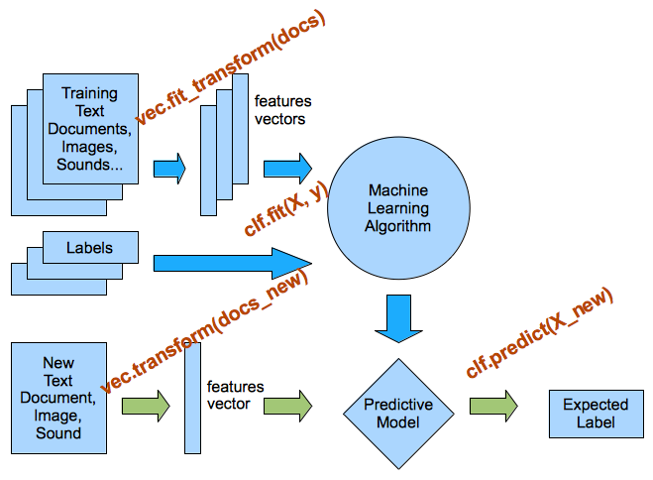
Preprocessing & Classification Overview

Slide 56
Day 2 Session
09.00 – 15.00
13 Cross-Validation
14 Model complexity and grid search for adjusting hyperparameters
15 Scikit-learn Pipelines
16 Supervised learning: Performance metrics for classification
17 Supervised learning: Linear Models
18 Supervised learning: Decision trees and random forests, ensemble methods
19 Supervised learning: Feature selection
20 Unsupervised learning: Hierarchical and density-based clustering algorithms
21 Unsupervised learning: Non-linear dimensionality reduction
22 Unsupervised learning: Anomaly detection
23 Automated machine learning

Slide 57
Holdout Evaluation I

Slide 58
Holdout Evaluation II

Slide 59
Holdout Validation I

Slide 60
Holdout Validation II

Slide 61
Holdout Validation III

Slide 62
K-fold Cross-Validation
5
5

Slide 63
K-fold Cross-Validation Pipeline I

Slide 64
K-fold Cross-Validation Pipeline II

Slide 65
Day 2 Session
09.00 – 15.00
13 Cross-Validation
14 Model complexity and grid search for adjusting hyperparameters
15 Scikit-learn Pipelines
16 Supervised learning: Performance metrics for classification
17 Supervised learning: Linear Models
18 Supervised learning: Decision trees and random forests, ensemble methods
19 Supervised learning: Feature selection
20 Unsupervised learning: Hierarchical and density-based clustering algorithms
21 Unsupervised learning: Non-linear dimensionality reduction
22 Unsupervised learning: Anomaly detection
23 Automated machine learning

Slide 66
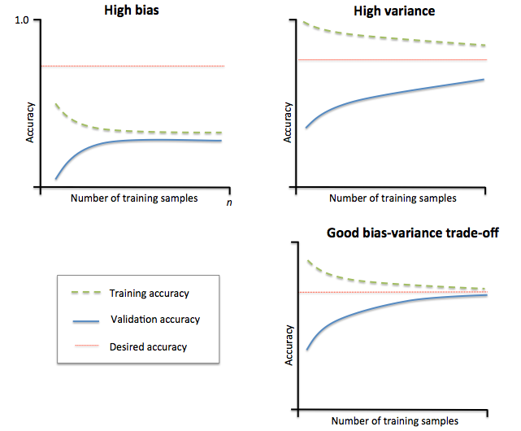
Learning Curves
Image source: https://github.com/rasbt/python-machine-learning-book/blob/master/code/ch06/images/06_04.png

Slide 67
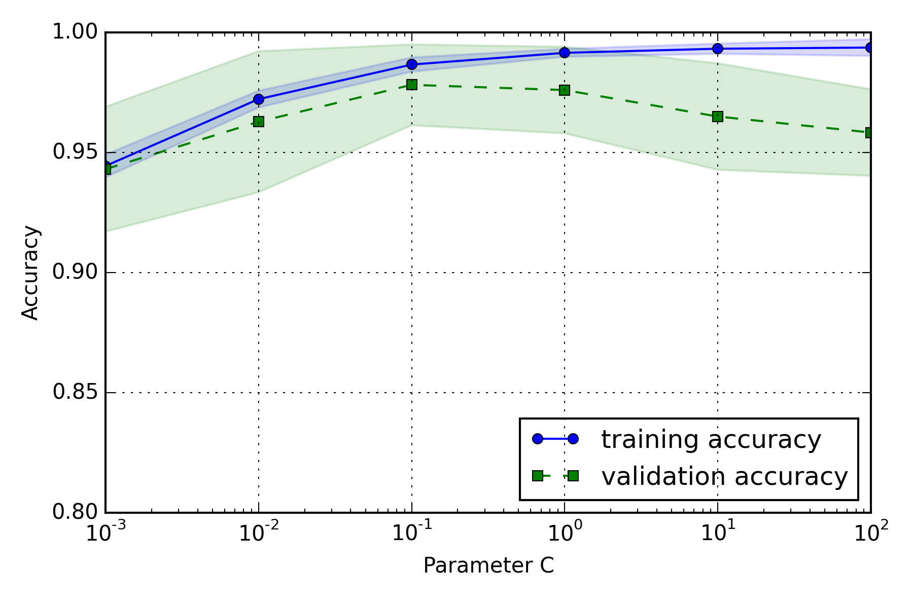
Model Complexity

Slide 68
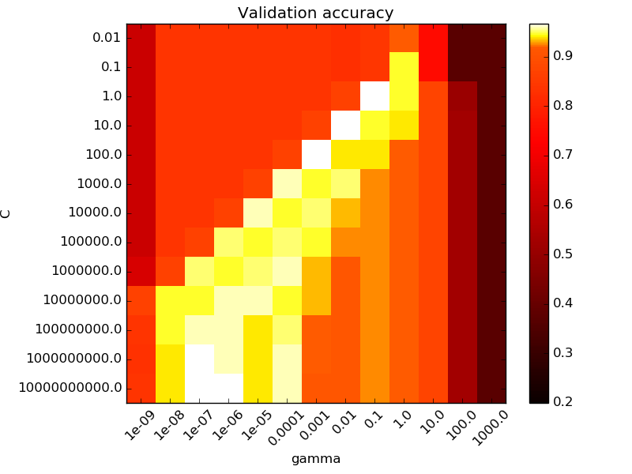
Grid Search
C parameter
gamma parameter
Source: http://scikit-learn.org/stable/auto_examples/svm/plot_rbf_parameters.html

Slide 69
Day 2 Session
09.00 – 15.00
13 Cross-Validation
14 Model complexity and grid search for adjusting hyperparameters
15 Scikit-learn Pipelines
16 Supervised learning: Performance metrics for classification
17 Supervised learning: Linear Models
18 Supervised learning: Decision trees and random forests, ensemble methods
19 Supervised learning: Feature selection
20 Unsupervised learning: Hierarchical and density-based clustering algorithms
21 Unsupervised learning: Non-linear dimensionality reduction
22 Unsupervised learning: Anomaly detection
23 Automated machine learning

Slide 70
Pipelines

Slide 71
Day 2 Session
09.00 – 15.00
13 Cross-Validation
14 Model complexity and grid search for adjusting hyperparameters
15 Scikit-learn Pipelines
16 Supervised learning: Performance metrics for classification
17 Supervised learning: Linear Models
18 Supervised learning: Decision trees and random forests, ensemble methods
19 Supervised learning: Feature selection
20 Unsupervised learning: Hierarchical and density-based clustering algorithms
21 Unsupervised learning: Non-linear dimensionality reduction
22 Unsupervised learning: Anomaly detection
23 Automated machine learning

Slide 72
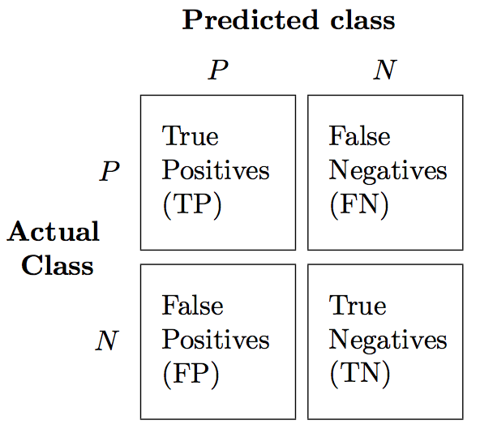
Confusion Matrix

Slide 73
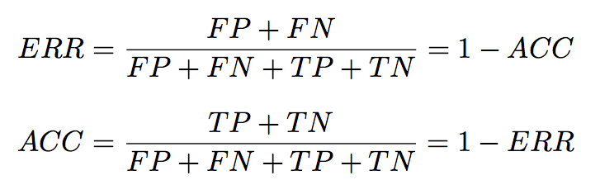
Classification Metrics I

Slide 74
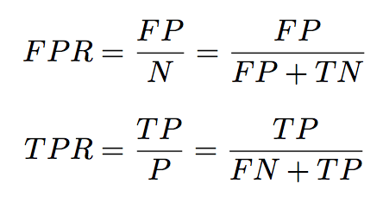
Classification Metrics II

Slide 75
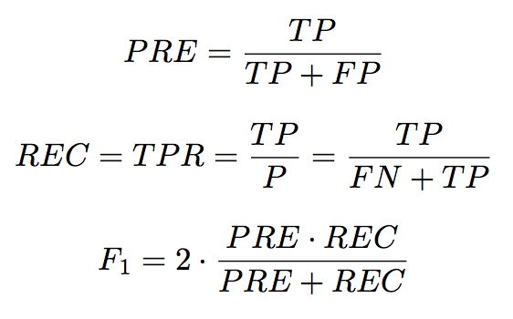
Classification Metrics III

Slide 76
Ultimately, metrics are arbitrary
Notes:
Think about what matters most for your problem: TP, FP, FN, TN?
e.g. with spam detection, TP and TN are good, FP means they have to check their spam folder, FN means one spam gets through → focus on maximizing TP/TN!
e.g. with cancer detection, TP and TN are good, FP cost an extra test, FN are disastrous → focus on minimizing FN!

Slide 77
Day 2 Session
09.00 – 15.00
13 Cross-Validation
14 Model complexity and grid search for adjusting hyperparameters
15 Scikit-learn Pipelines
16 Supervised learning: Performance metrics for classification
17 Supervised learning: Linear Models
18 Supervised learning: Decision trees and random forests, ensemble methods
19 Supervised learning: Feature selection
20 Unsupervised learning: Hierarchical and density-based clustering algorithms
21 Unsupervised learning: Non-linear dimensionality reduction
22 Unsupervised learning: Anomaly detection
23 Automated machine learning

Slide 78
Linear models for regression
y_pred = x_test[0] * coef_[0] + ...
+ x_test[n_features-1] * coef_[n_features-1]
+ intercept_
y
slope (=Δy/Δx)
x[0]

Slide 79
Day 2 Session
09.00 – 15.00
13 Cross-Validation
14 Model complexity and grid search for adjusting hyperparameters
15 Scikit-learn Pipelines
16 Supervised learning: Performance metrics for classification
17 Supervised learning: Linear Models
18 Supervised learning: Decision trees and random forests, ensemble methods
19 Supervised learning: Feature selection
20 Unsupervised learning: Hierarchical and density-based clustering algorithms
21 Unsupervised learning: Non-linear dimensionality reduction
22 Unsupervised learning: Anomaly detection
23 Automated machine learning

Slide 80
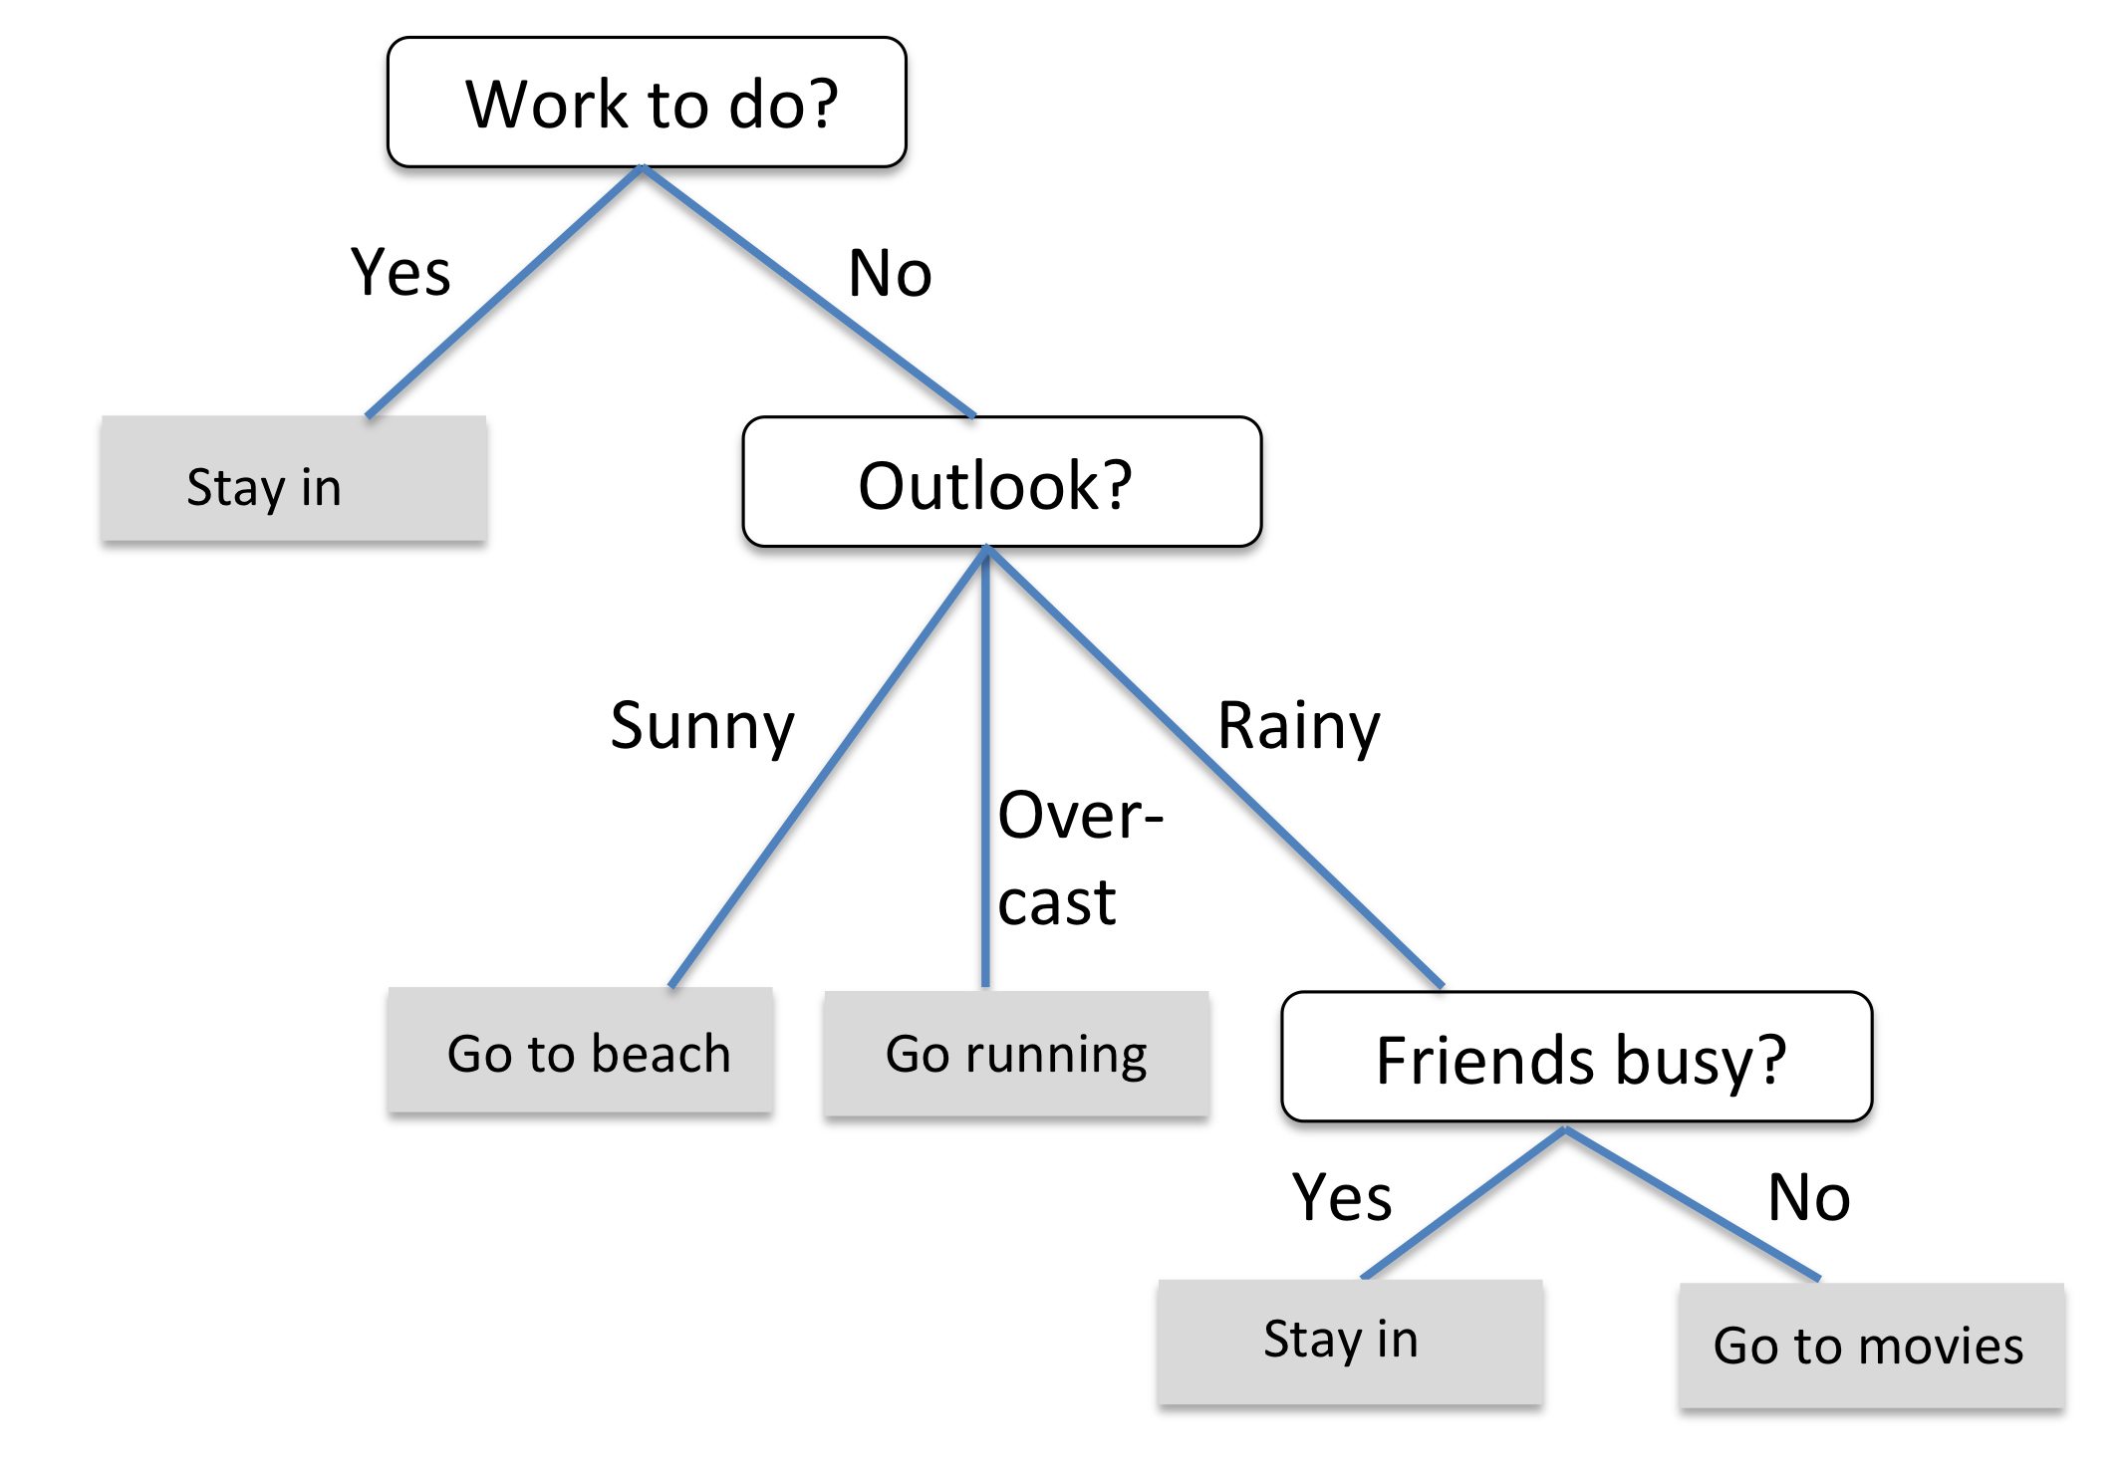
Decision Trees

Slide 81
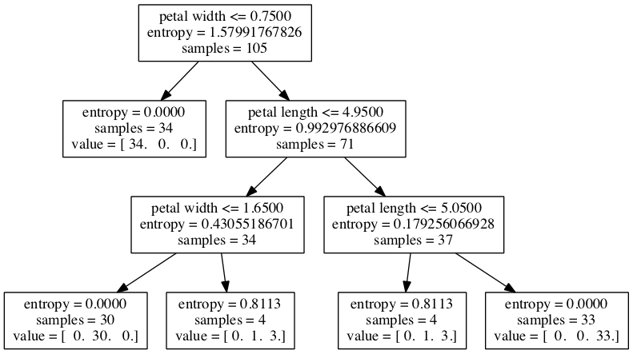
Classification w/ Continuous Features

Slide 82
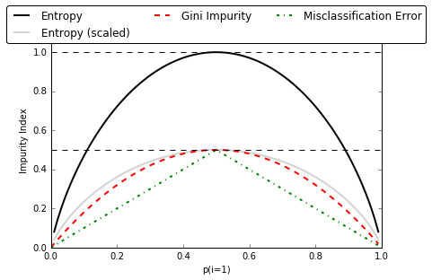
Impurity measures

Slide 83
Ensemble Methods
Bagging
Boosting
Random
Forests

Slide 84
Day 2 Session
09.00 – 15.00
13 Cross-Validation
14 Model complexity and grid search for adjusting hyperparameters
15 Scikit-learn Pipelines
16 Supervised learning: Performance metrics for classification
17 Supervised learning: Linear Models
18 Supervised learning: Decision trees and random forests, ensemble methods
19 Supervised learning: Feature selection
20 Unsupervised learning: Hierarchical and density-based clustering algorithms
21 Unsupervised learning: Non-linear dimensionality reduction
22 Unsupervised learning: Anomaly detection
23 Automated machine learning

Slide 85
Dimensionality Reduction
Dimensionality Reduction
Feature Selection
Feature Extraction

Slide 86
Day 2 Session
09.00 – 15.00
13 Cross-Validation
14 Model complexity and grid search for adjusting hyperparameters
15 Scikit-learn Pipelines
16 Supervised learning: Performance metrics for classification
17 Supervised learning: Linear Models
18 Supervised learning: Decision trees and random forests, ensemble methods
19 Supervised learning: Feature selection
20 Unsupervised learning: Hierarchical and density-based clustering algorithms
21 Unsupervised learning: Non-linear dimensionality reduction
22 Unsupervised learning: Anomaly detection
23 Automated machine learning

Slide 87
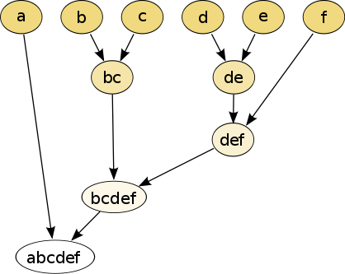
Hierarchical Clustering
https://en.wikipedia.org/wiki/Hierarchical_clustering#/media/File:Hierarchical_clustering_simple_diagram.svg [CC BY-SA 3.0]

Slide 88
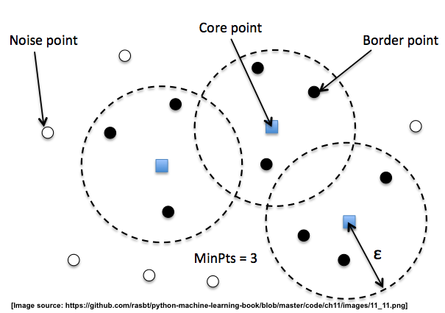
DBSCAN

Slide 89
Day 2 Session
09.00 – 15.00
13 Cross-Validation
14 Model complexity and grid search for adjusting hyperparameters
15 Scikit-learn Pipelines
16 Supervised learning: Performance metrics for classification
17 Supervised learning: Linear Models
18 Supervised learning: Decision trees and random forests, ensemble methods
19 Supervised learning: Feature selection
20 Unsupervised learning: Hierarchical and density-based clustering algorithms
21 Unsupervised learning: Non-linear dimensionality reduction
22 Unsupervised learning: Anomaly detection
23 Automated machine learning

Slide 90
PCA
2D
1D
?

Slide 91
PCA
2D
1D

Slide 92
Kernel PCA
2D
1D

Slide 93
Day 2 Session
09.00 – 15.00
13 Cross-Validation
14 Model complexity and grid search for adjusting hyperparameters
15 Scikit-learn Pipelines
16 Supervised learning: Performance metrics for classification
17 Supervised learning: Linear Models
18 Supervised learning: Decision trees and random forests, ensemble methods
19 Supervised learning: Feature selection
20 Unsupervised learning: Hierarchical and density-based clustering algorithms
21 Unsupervised learning: Non-linear dimensionality reduction
22 Unsupervised learning: Anomaly detection
23 Automated machine learning

Slide 94
Day 2 Session
09.00 – 15.00
13 Cross-Validation
14 Model complexity and grid search for adjusting hyperparameters
15 Scikit-learn Pipelines
16 Supervised learning: Performance metrics for classification
17 Supervised learning: Linear Models
18 Supervised learning: Decision trees and random forests, ensemble methods
19 Supervised learning: Feature selection
20 Unsupervised learning: Hierarchical and density-based clustering algorithms
21 Unsupervised learning: Non-linear dimensionality reduction
22 Unsupervised learning: Anomaly detection
23 Automated machine learning

Slide 95

scikit-learn.org/stable/tutorial/machine_learning_map/index.html

Slide 96
What to do next?
Practice
Kaggle.com
UCI Machine Learning repository
Learn advanced ML methods
XGBoost
Deep Learning
Learn ML model deployment
Flask or Heroku

Slide 97
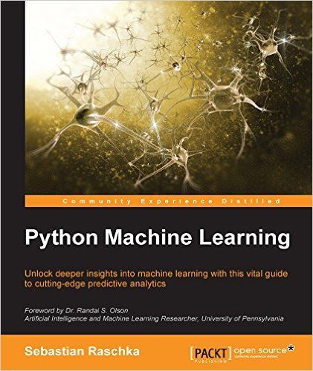
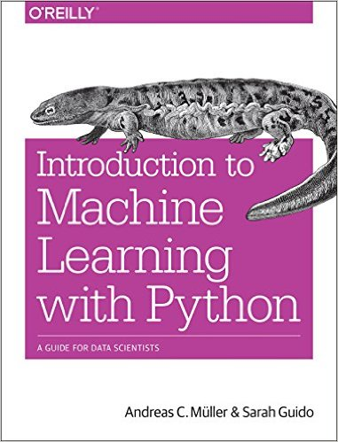
Recommended Books I

Slide 98
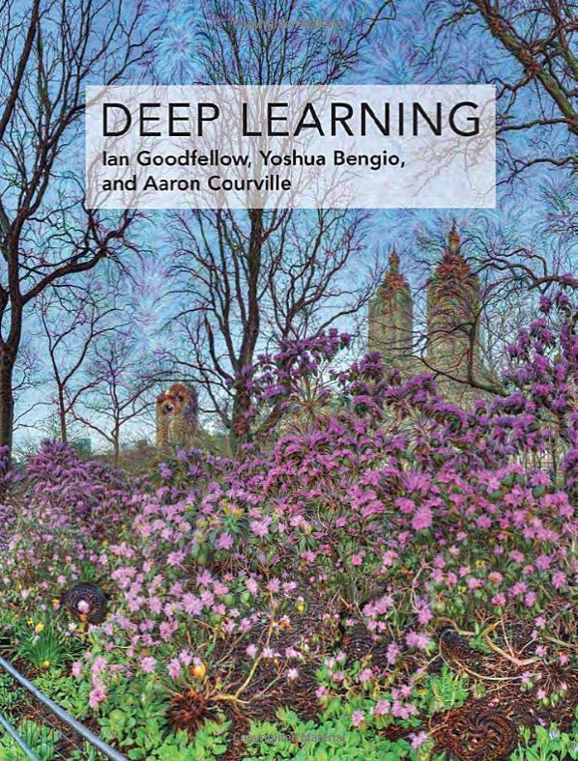
Recommended Books II
DeepLearningBook.org

Slide 99
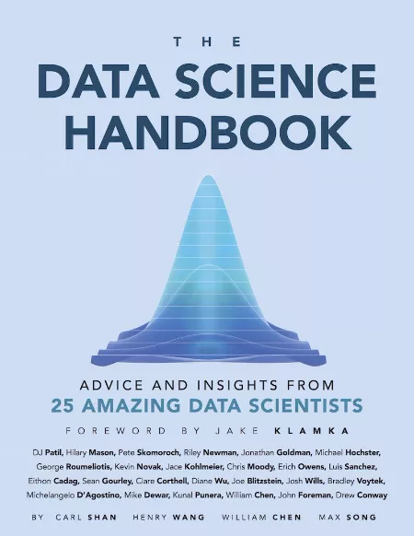
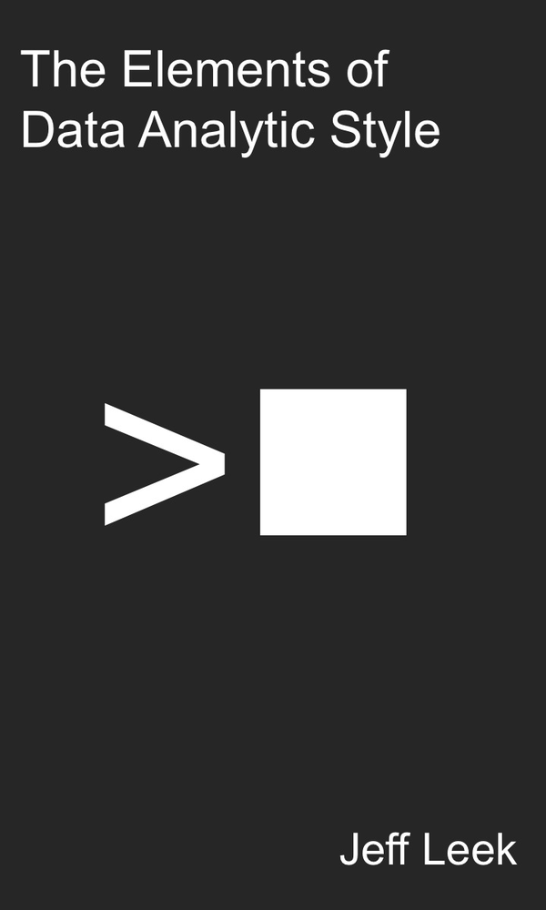
Recommended Books III

Slide 100
Recommended Courses
Machine Learning (Coursera)
coursera.org/learn/machine-learning
Deep Learning (Udacity)
udacity.com/course/deep-learning--ud730
ML model deployment (Udemy)
udemy.com/course/deployment-of-machine-learning-models/

Slide 101
What to do next?
Contribute
github.com/scikit-learn/scikit-learn
scikit-learn.org/stable/related_projects.html

